Slide 1



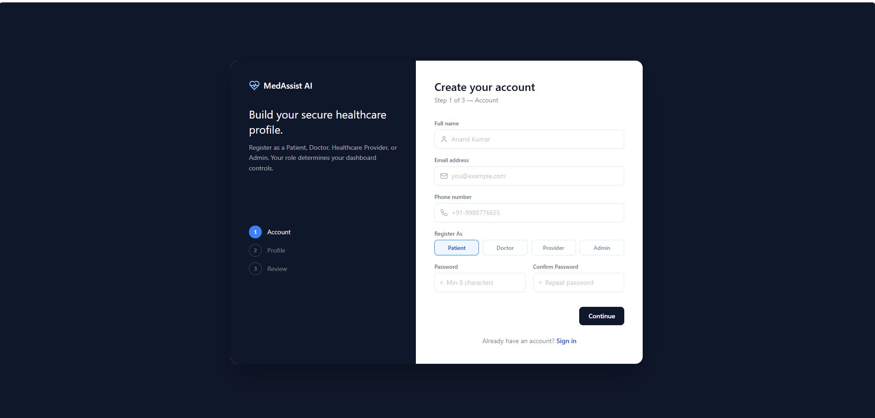
MEDASSIST AI: MEDICAL SYMPTOM ANALYSIS & DISEASE PREDICTION SYSTE
👤 Patient Dashboard
Check symptoms
View reports
Manage profile
👨‍⚕️ Doctor Dashboard
View patient details
Give treatment
Manage appointments
🏥 Healthcare Provider Dashboard
Manage patient record
Monitor healthcare services
👨‍💼 Admin Dashboard
Manage users
Monitor system
View analytics

Slide 2

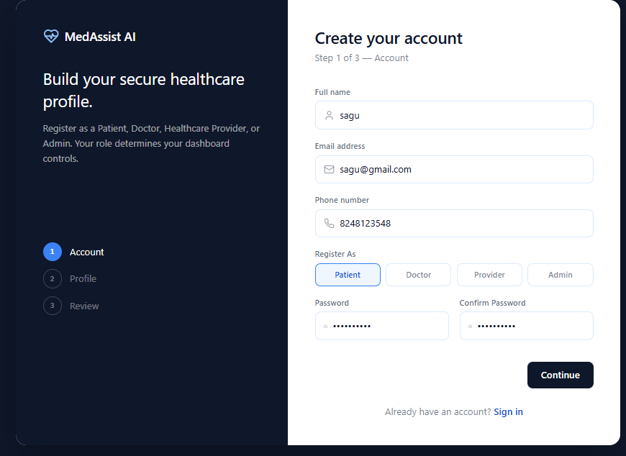
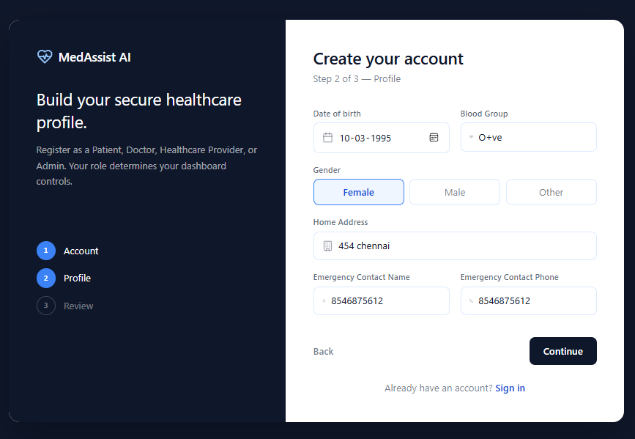
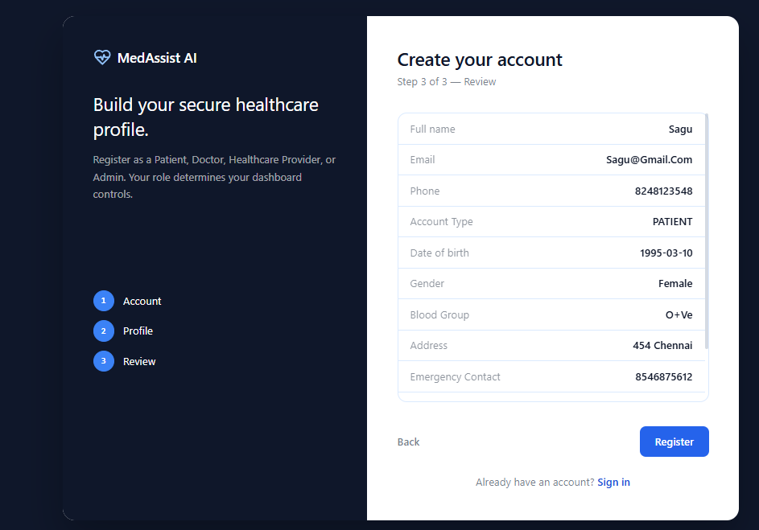
Patient Dashboard Overview
Objective
Provides a personalized healthcare dashboard for patients.
Displays health information in one place.
Easy navigation for medical services.
Features
Welcome Dashboard
Health Score
Search Bar
Quick Access Buttons
User Profile

Slide 3
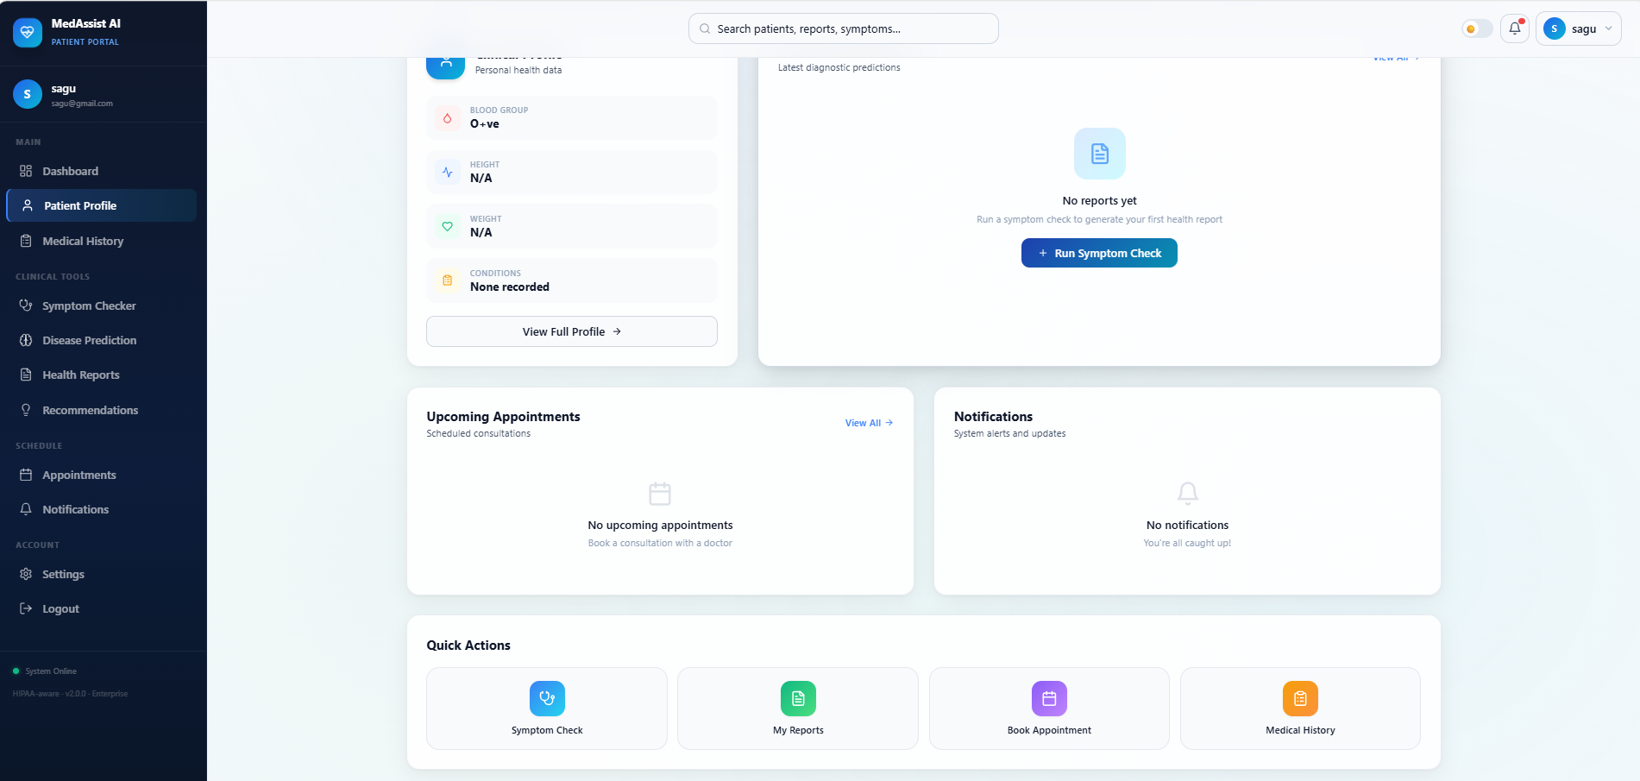
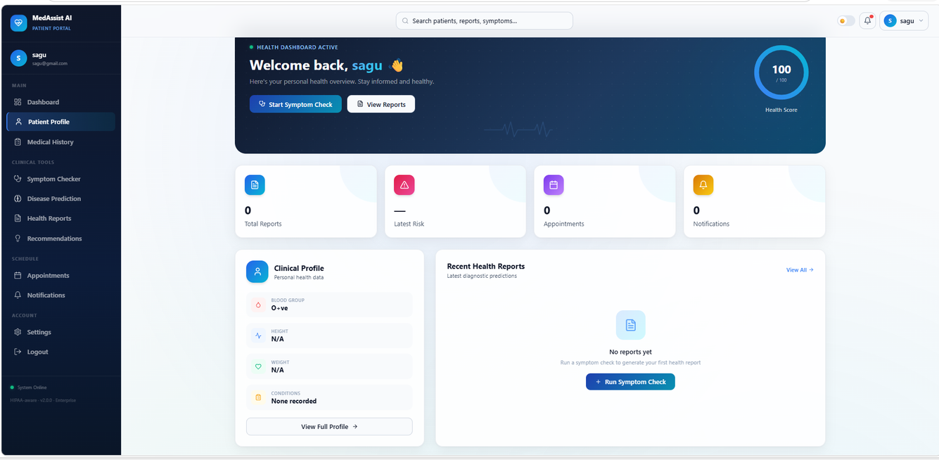
Clinical Profile
Displays Blood Group
Height & Weight
Medical Conditions
Health Reports
View disease prediction reports
Download health reports
Appointments & Notifications
Upcoming appointments
System notifications and alerts
Quick Actions
Symptom Check
My Reports
Book Appointment
Medical History

Slide 4

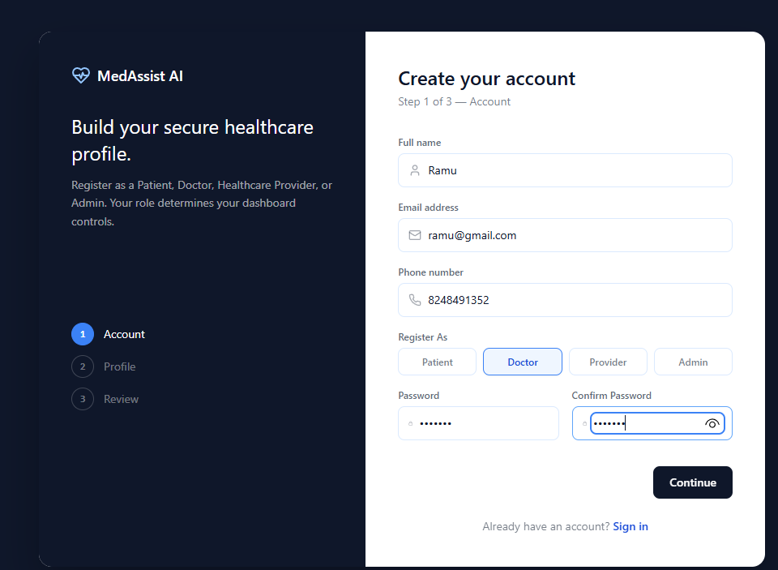
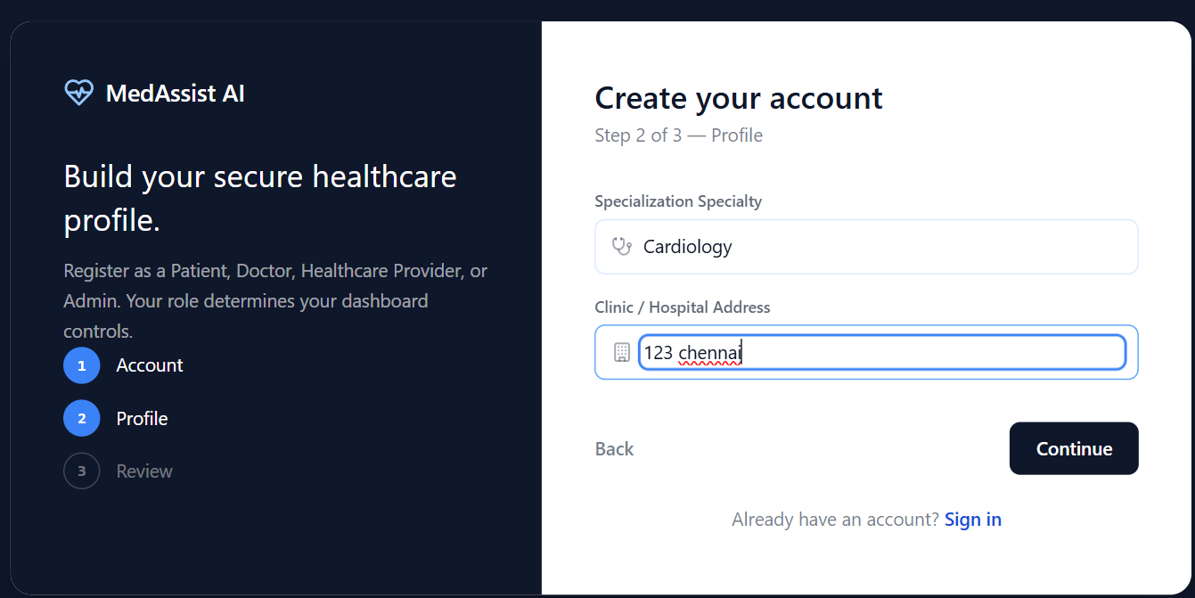
Doctor Dashboard
View patient details
Review symptoms & disease prediction
Provide treatment recommendations
Manage appointments
Monitor patient health reports
www.reallygreatsite.com

Slide 5
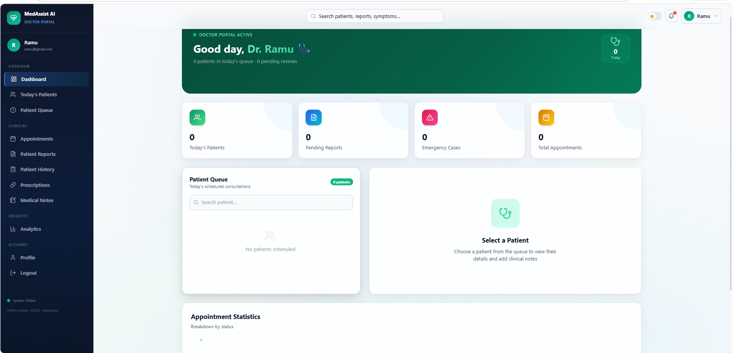
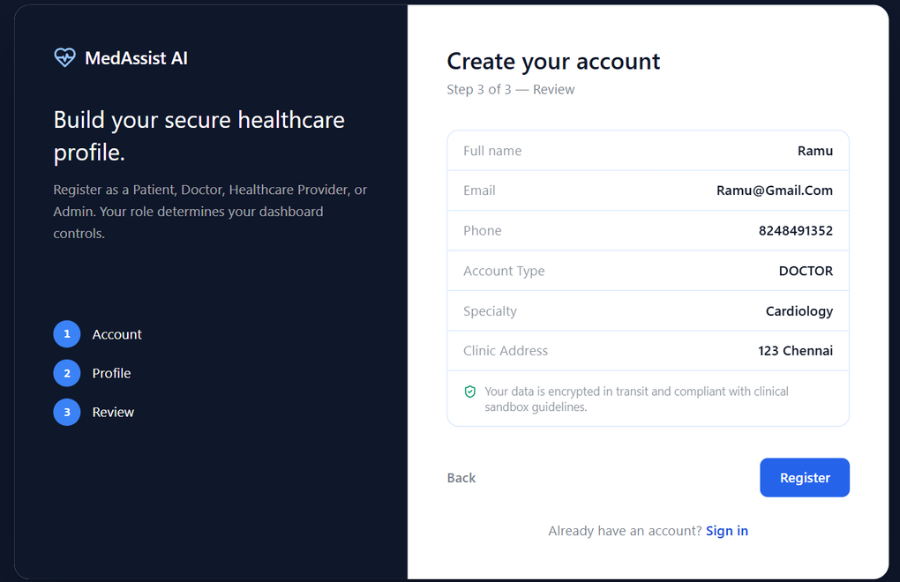

Slide 6
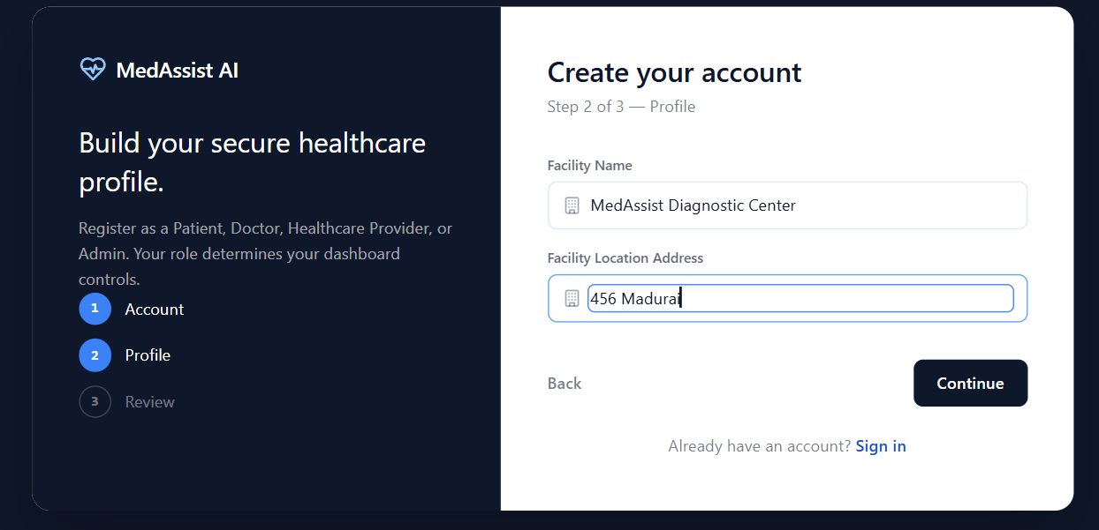

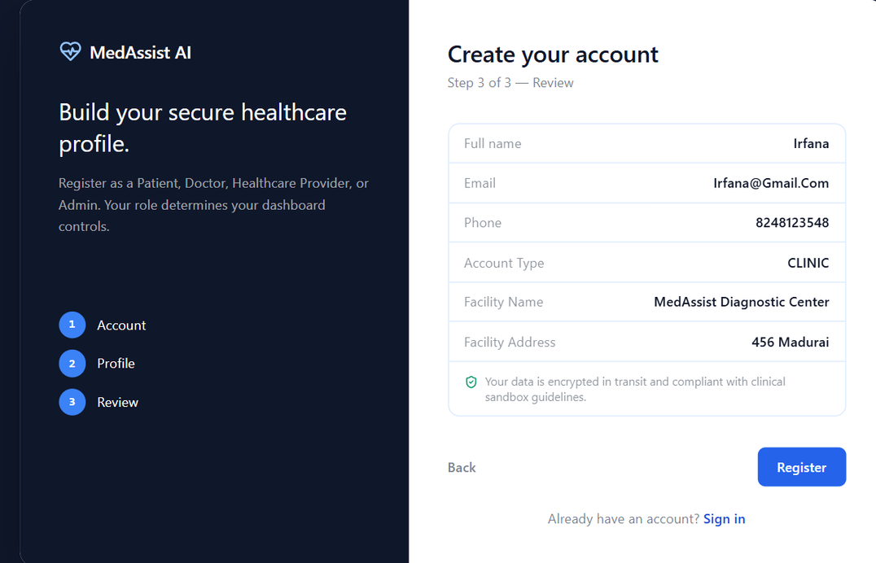
prprovider dashboardoviro

Slide 7
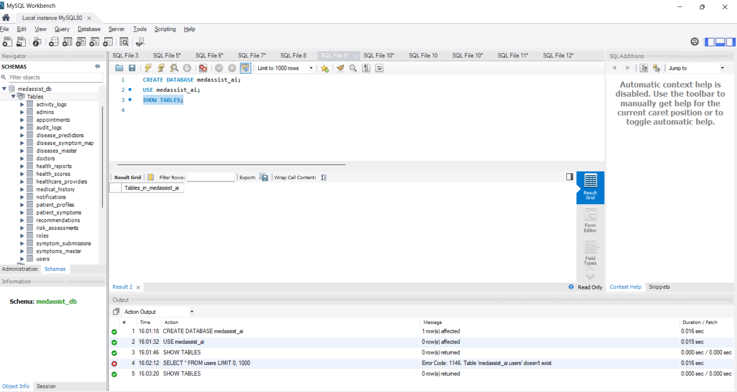
Mysql working

